Slide 1

Spark Architecture

Slide 2

Components High Level
Master/WorkerAchitecture.
Spark Driver Program
SparkContext
Cluster Manager
Spark Session
Executors
Task
Shuffle & Result
Image source: https://spark.apache.org/docs/latest/cluster-overview.html

Slide 3
What is the Spark Driver
There are M-M clusters though!
Coordinates and executes Spark applications
Runs on master node
Creates the execution plan
Distributes & coordinate tasks across worker nodes
Tracks the progress and status of tasks
It handles failures and retries for fault tolerance.
Aggregates and returns the results to app
1 cluster = 1 master
1 driver = 1 application
Image: spark.apache.org/docs/latest/cluster-overview.html

Slide 4
What is the Spark Context
Entry point for interacting with Apache Spark.
In addition to Spark Session
Interface for creating RDDs* and executing Spark operations.
Coordinates the execution of Spark applications across the cluster.
It manages the distribution of tasks, resource allocation, and fault tolerance mechanisms.
Image: spark.apache.org/docs/latest/cluster-overview.html
*RDD = resilient distributed dataset (more to come!)

Slide 5
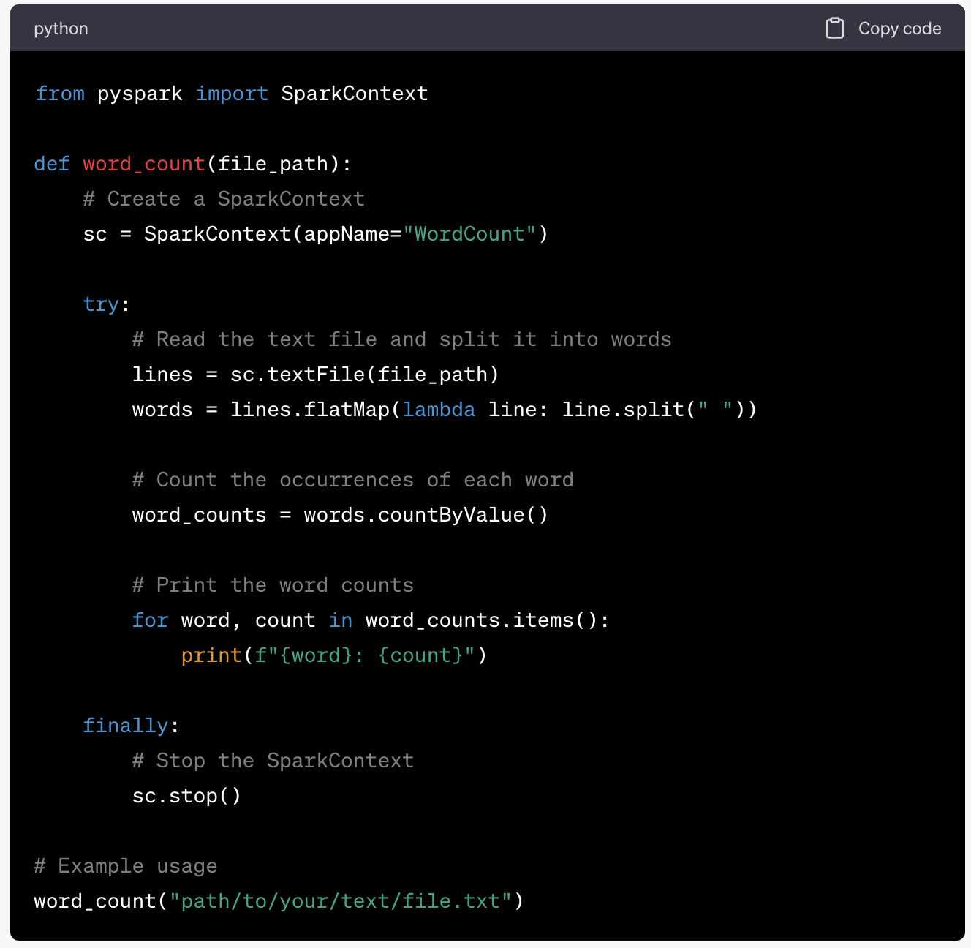
Image: spark.apache.org/docs/latest/cluster-overview.html
What is the Spark Context
Provides a unified programming API for various programming languages:
e.g. Scala, Java, Python, and R, enabling developers to write Spark applications in their preferred language.
Handles the configuration of Spark application properties and environment settings.
Controls the parallelism and data partitioning, optimizing data processing across multiple nodes in a cluster.

Slide 6
What is the Spark Context
It enables the caching and persistence of intermediate data in memory or on disk
Integrates with various data sources, file systems, and third-party libraries (diverse formats)
Monitoring management for Spark applications: job progress, resource usage, and execution metrics.
Image: spark.apache.org/docs/latest/cluster-overview.html

Slide 7
Next…
Master/WorkerAchitecture.
Spark Driver Program
SparkContext
Cluster Manager
Spark Session
Executors
Task
Shuffle & Result

